Slide 1
More deep learning & Introduction to Keras

Slide 2
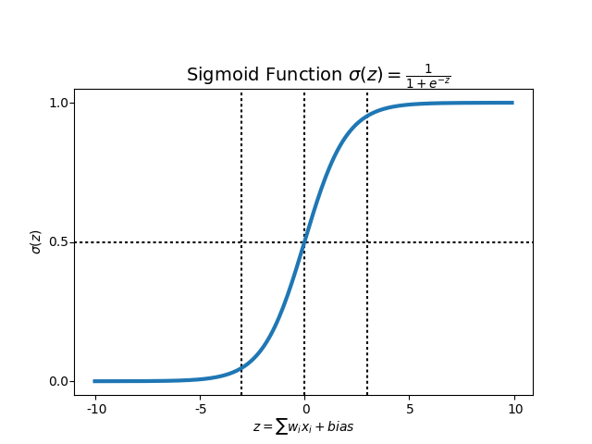


















Artificial neural networks: computational architecture overview
$$y$$
$$X$$
$$a^{[1]}$$
$$W^{[1]}$$
$$W^{[2]}$$
$$a^{[2]}$$
$$W^{[3]}$$
$$x1$$
$$x2$$
$$x3$$
$$W_{11}$$
$$W_{21}$$
$$W_{31}$$
Activation function
Activation function
Activation function
$$W_{11}$$
$$x_{1}$$
$$W_{21}$$
$$W_{31}$$
$$x_{2}$$
$$x_{3}$$
Input layer
Hidden layer 1
Hidden layer 2
Output layer

Slide 3
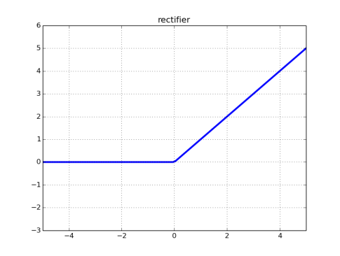
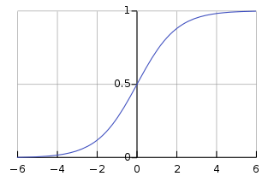

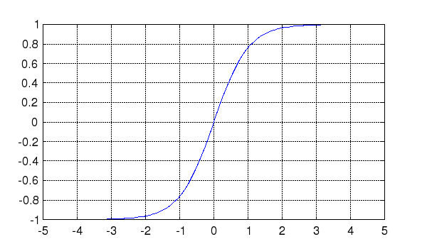







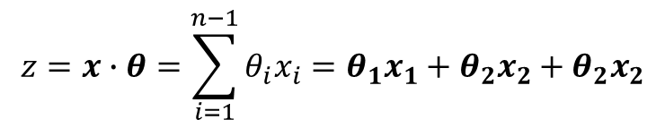


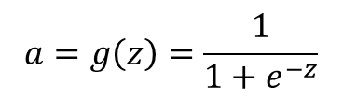



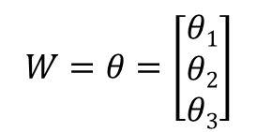


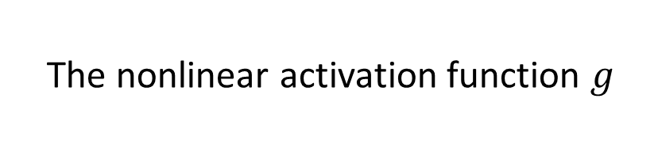

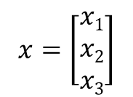


The nonlinear activation function $g$
rectifier neural unit (reLU ()
$$a$$
The activation function of each neuron unit is generally non-linear.
Linear functions are limited because the output is simply proportional to the input.
$$a=g\left(z\right)=max⁡(0,z)$$
$$z$$
$$x=\left[\begin{matrix}x1 \\ x2 \\ x3\end{matrix}\right]$$
$$W=θ=\left[\begin{matrix}θ1 \\ θ2 \\ θ3\end{matrix}\right]$$
sigmoid
$$a$$
$$a=g\left(z\right)=\frac{1}{1+e^{−z}}$$
$$z=x∙θ=\sum_{i=1}^{n−1}{θ_{i}x_{i}}=θ_{1}x_{1}+θ_{2}x_{2}+θ_{2}x_{2}$$
$$a=g\left(z\right)=g(\sum_{i=1}^{n−1}{θ_{i}x_{i}})$$
$$z$$
$$θ1$$
Hyperbolic tangent
$$θ2$$
$$a$$
$$a=g\left(z\right)=\frac{e^{z}−e^{−z}}{e^{z}+e^{−z}}$$
$$z$$
$$a=g(z)$$
$$a$$
$$θ3$$
$$z$$

Slide 4
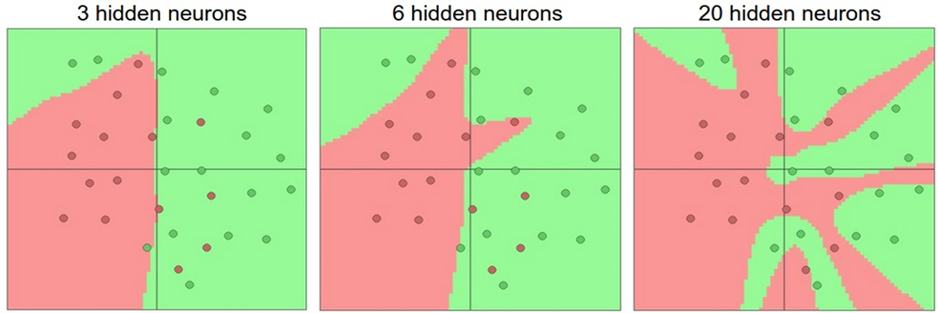
Neural networks and overfitting
“Small” neural network
(fewer parameters; more prone to underfitting, high bias)
“Large” neural network
(more parameters; more prone to overfitting, low bias)
Computationally cheaper
Computationally more expensive.
We can use regularization to address overfitting
15

Slide 5
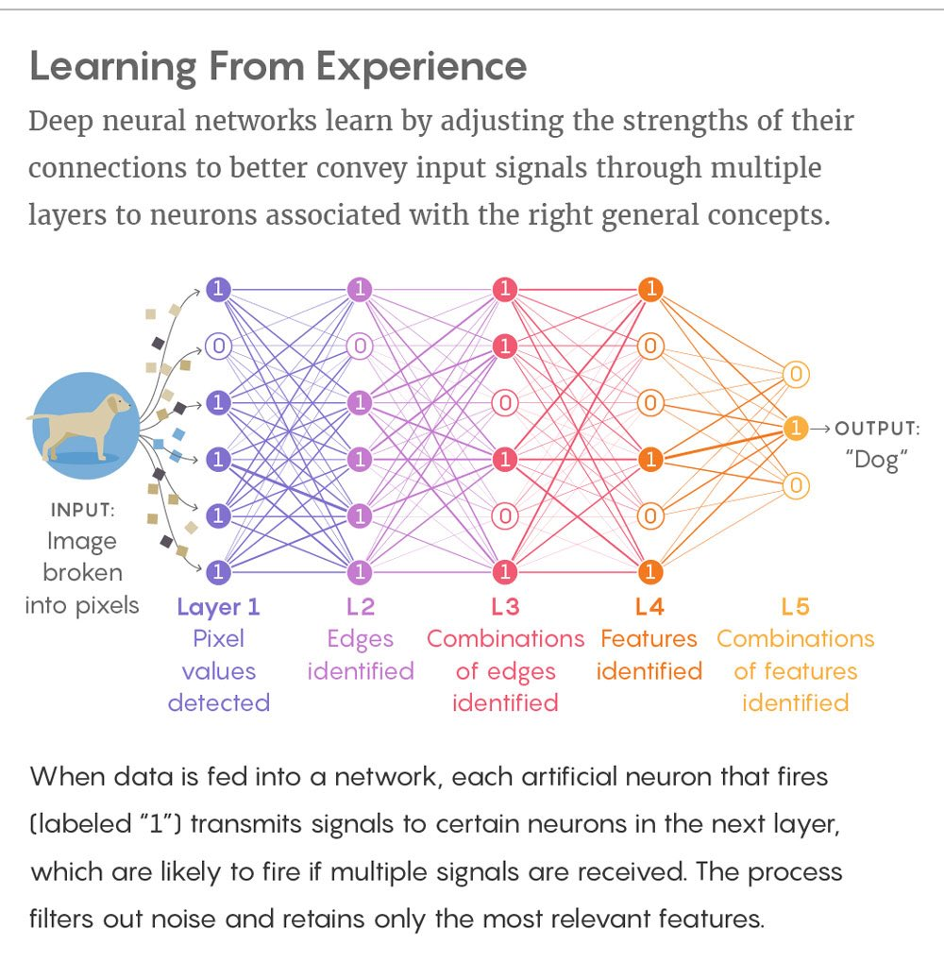
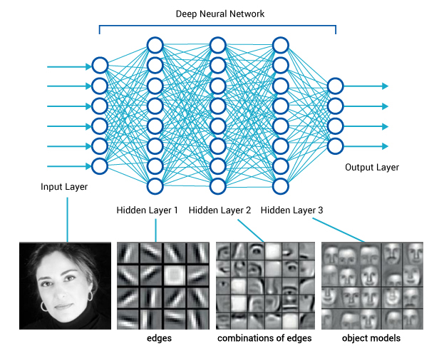
The reason why deep models work so well is that a lot of natural phenomena tend to have a hierarchical structure of features that deep models naturally capture
Hierarchical representations creates parameter efficiency since higher-level representations share lower level parameters
Hierarchical representations are key for the generalization abilities of the network
Notes:
Theoretically, any deep neural network could be represented as a single layer network. But such a representation is inefficient since it leads to a combinatorial explosion of parameters. A deep network allows the representation of complex functions while preventing the combinatorial explosions of parameters by building hierarchical representations of lower level features.

Slide 6
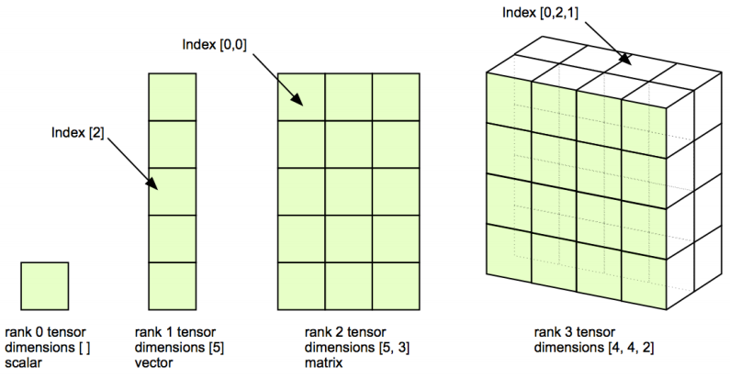
Data representations for neural networks: tensors
All modern machine-learning systems use tensors as their basic data structure
At its core, a tensor is a container for data—almost always numerical data
You are already familiar with matrices, which are 2D tensors
tensors are a generalization of matrices to an arbitrary number of dimensions
in the context of tensors, a dimension is often called an axis

Slide 7
Scalars (0D tensors):
A tensor that contains only one number is called a scalar (or scalar tensor, or 0-dimensional tensor, or 0D tensor)
You can display the number of axes of a Numpy tensor via the ndim attribute;
a scalar tensor has 0 axes (ndim == 0). The number of axes of a tensor is also called its rank.
>>> import numpy as np
>>> x = np.array(12)
>>> x
array(12)
>>> x.ndim
0

Slide 8
Vectors (1D tensors)
An array of numbers is called a vector, or 1D tensor
A 1D tensor is said to have exactly one axis.
In the code example below the vector x has five entries and so is called a 5-dimensional vector. Don’t confuse a 5D vector with a 5D tensor! A 5D vector has only one axis and has five dimensions along its axis, whereas a 5D tensor has five axes (and may have any number of dimensions along each axis).
Dimensionality can denote either the number of entries along a specific axis (as in the case of our 5D vector) or the number of axes in a tensor (such as a 5D tensor), which can be very confusing at times.
In the latter case, it’s technically more correct to talk about a tensor of rank 5 (the rank of a tensor being the number of axes), but the ambiguous notation 5D tensor is common regardless.
>>> x = np.array([12, 3, 6, 14])
>>> x
array([12, 3, 6, 14])
>>> x.ndim
1

Slide 9
Matrices (2D tensors)
An array of vectors is a matrix, or 2D tensor
A matrix has two axes (often referred to rows and columns).
You can visually interpret a matrix as a rectangular grid of numbers.
>>> x = np.array([
[5, 78, 2, 34, 0],
[6, 79, 3, 35, 1],
[7, 80, 4, 36, 2]
])
>>> x.ndim
2

Slide 10
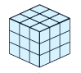
3D tensors and higher-dimensional tensors
>>> x = np.array([
[
[5, 78, 2, 34, 0],
[6, 79, 3, 35, 1],
[7, 80, 4, 36, 2]
],
[
[5, 78, 2, 34, 0],
[6, 79, 3, 35, 1],
[7, 80, 4, 36, 2]
],
[
[5, 78, 2, 34, 0],
[6, 79, 3, 35, 1],
[7, 80, 4, 36, 2]
]
])
>>> x.ndim
3
If you pack such matrices in a new array, you obtain a 3D tensor, which you can visually interpret as a cube of numbers.

Slide 11
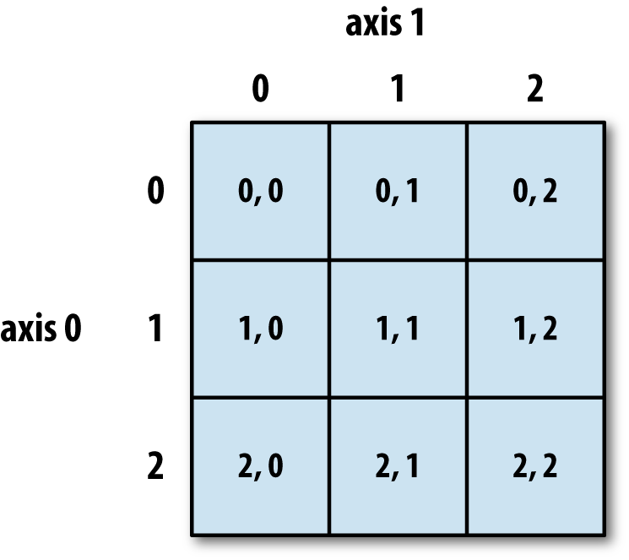
Key attributes of tensors
A tensor is defined by three key attributes:
Number of axes (rank): For instance, a 3D tensor has three axes, and a matrix has two axes. This is also called the tensor’s ndim in Python libraries such as Numpy.
Shape: This is a tuple of integers that describes how many dimensions the tensor has along each axis.
Data type: This is the type of the data contained in the tensor; for instance, a tensor’s type could be float32, int8, float64, and so on.
from keras.datasets import mnist
(train_images, train_labels), (test_images, test_labels) = mnist.load_data()
>>> print(train_images.ndim)
3
>>> print(train_images.shape)
(60000, 28, 28)
>>> print(train_images.dtype)
uint8
Notes:
On rare occasions, you may see a char tensor. Note that string tensors don’t exist in Numpy (or in most other libraries), because tensors live in preallocated, contiguous memory segments: and strings, being variable length, would preclude the use of this implementation.

Slide 12




Real-world examples of data tensors
$$X$$
$$x1$$
$$x2$$
$$x3$$
Vector data—2D tensors of shape (samples, features)
An actuarial dataset of people, where we consider each person’s age, ZIP code, and income. Each person can be characterized as a vector of 3 values, and thus an entire dataset of 100,000 people can be stored in a 2D tensor of shape (100000, 3).
Timeseries data or sequence data—3D tensors of shape (samples, timesteps, features)
Whenever time matters in your data (or the notion of sequence order), it makes sense to store it in a 3D tensor with an explicit time axis.
Images—4D tensors of shape (samples, height, width, channels) or (samples, channels, height, width)
Video—5D tensors of shape (samples, frames, height, width, channels) or (samples, frames, channels, height, width)
Notes:
Images typically have three dimensions: height, width, and color depth. Although
grayscale images (like our MNIST digits) have only a single color channel and could
thus be stored in 2D tensors, by convention image tensors are always 3D, with a onedimensional
color channel for grayscale images. A batch of 128 grayscale images of
size 256 × 256 could thus be stored in a tensor of shape (128, 256, 256, 1), and a
batch of 128 color images could be stored in a tensor of shape (128, 256, 256, 3)
(see figure 2.4).

Slide 13
The notion of data batches
In general, the first axis (axis 0, because indexing starts at 0) in all data tensors you’ll come across in deep learning will be the samples axis
In the MNIST example, samples are images of digits.
In addition, deep-learning models don’t process an entire dataset at once; rather, they break the data into small batches.
When considering such a batch tensor, the first axis (axis 0) is called the batch axis or batch dimension
batch1 = train_images[:128]
batch2 = train_images[128:256]
batchn = train_images[128 * n:128 * (n + 1)]

Slide 14
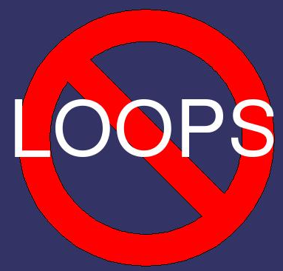
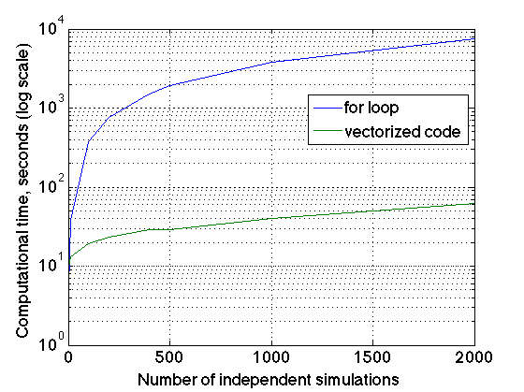
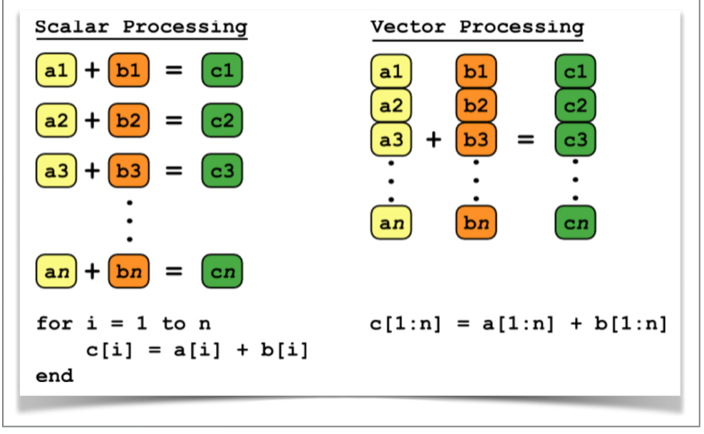
Vectorized computation
To optimize computational speed, machine learning libraries avoid explicit for loops whenever possible
The relu operation and vector addition are element-wise operations: operations that are applied independently to each entry in the tensors being considered.
This means these operations are highly amenable to massively parallel implementations (vectorised implementations)
In practice, when dealing with Numpy arrays, these operations are available as well optimized built-in Numpy functions, which themselves delegate the heavy lifting to a Basic Linear Algebra Subprograms (BLAS) implementation
BLAS are low-level, highly parallel, efficient tensor-manipulation routines that are typically implemented in Fortran or C.

Slide 15
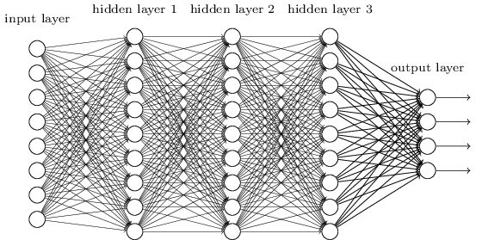
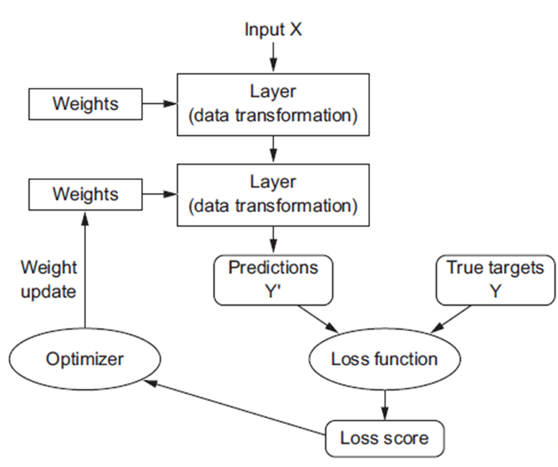
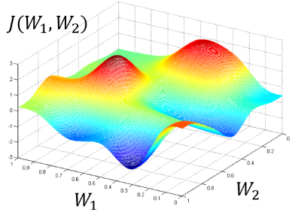
Anatomy of a neural network
Training a neural network revolves around the following objects:
Layers, which are combined into a network (or model)
The input data and corresponding targets
The loss function, which defines the feedback signal used for learning
The optimizer, which determines how learning proceeds
The network, composed of layers that are chained together, maps the input data to predictions
The loss function then compares these predictions to the targets, producing a loss value: a measure of how well the network’s predictions match what was expected
The optimizer uses this loss value to update the network’s weights
Notes:
yeah

Slide 16
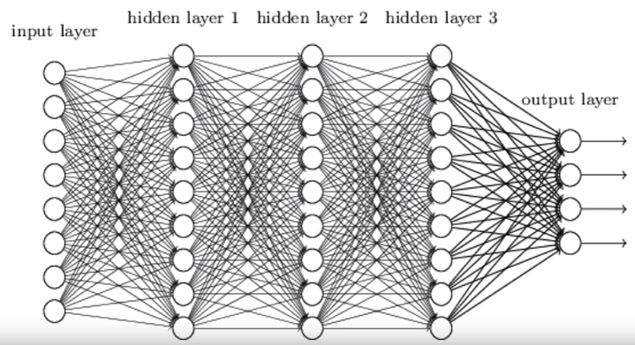
Layers: the building blocks of deep learning
The fundamental data structure in neural networks is the layer
A layer is a data-processing module that takes as input one or more tensors and that outputs one or more tensors
Some layers are stateless, but more frequently layers have a state: the layer’s weights, one or several tensors learned with stochastic gradient descent, which together contain the network’s memory/knowledge
Different layers are appropriate for different tensor formats and different types of data processing

Slide 17
Models: networks of layers
A deep-learning model is a directed, acyclic graph of layers.
The most common instance is a linear stack of layers, mapping a single input to a single output
The topology of a network defines a hypothesis space.
We previously defined machine learning as searching for useful representations of some input data, within a predefined space of possibilities, using guidance from a feedback signal.
By choosing a network topology, you constrain your space of possibilities (hypothesis space) to a specific series of tensor operations, mapping input data to output data.
What you’ll then be searching for is a good set of values for the weight tensors involved in these tensor operations.

Slide 18

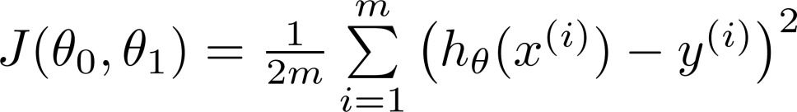
Loss functions and optimizers: keys to configuring the learning process
Once the network architecture is defined, you still have to choose two more things:
Loss function (objective function)—The quantity that will be minimized during training
It represents a measure of success for the task at hand
Optimizer—Determines how the network weights will be updated based on the loss function.
It implements a specific variant of gradient descent (SGD)
Notes:
We will use binary crossentropy for a two-class classification
problem, categorical crossentropy for a many-class classification problem, meansquared
error for a regression problem, connectionist temporal classification (CTC)
for a sequence-learning problem, and so on.

Slide 19
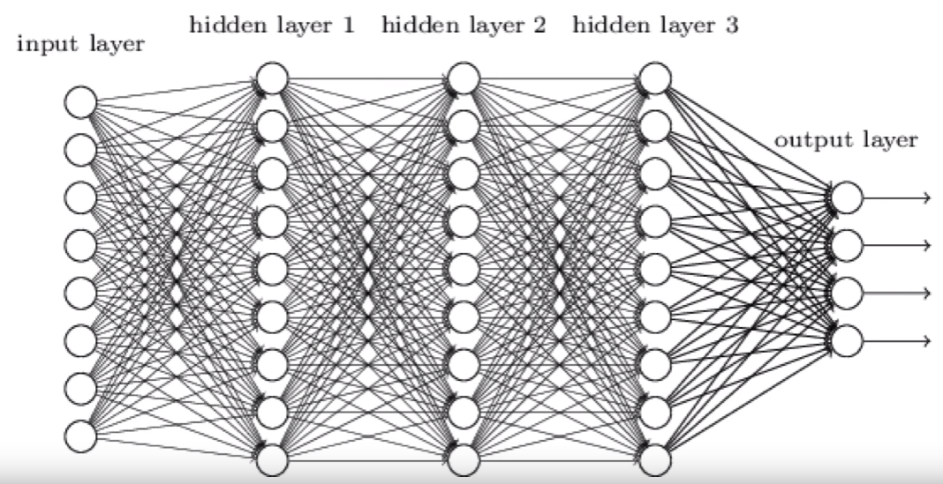









Optimizer: The engine of neural networks (gradient-based optimization)
each neural layer from an archetypal network transforms its input data as follows:
output = relu(dot(W, input) + b)
In this expression, W and b are tensors that are attributes of the layer. They’re called the weights or trainable parameters of the layer
These weights contain the information learned by the network from exposure to training data.
Initially, these weight matrices are filled with small random values (a step called random initialization).
Of course, there’s no reason to expect that relu(dot(W, input) + b), when W and b are random, will yield any useful representations.
The resulting representations are meaningless—but they’re a starting point.
What comes next is to gradually adjust these weights, based on a feedback signal.
This gradual adjustment, also called training, is basically the learning that machine learning is all about.
Forward pass (input signals)
$$y$$
$$x$$
$$W_{1}$$
$$a_{1}$$
$$W_{2}$$
$$a_{2}$$
$$W_{3}$$
$$a_{3}$$
$$W_{4}$$
$$y={g(W}_{4}∙{g(W}_{3}∙{g(W}_{2}{∙g(W}_{1}∙x))))$$
Back propagation ( error signal)

Slide 20
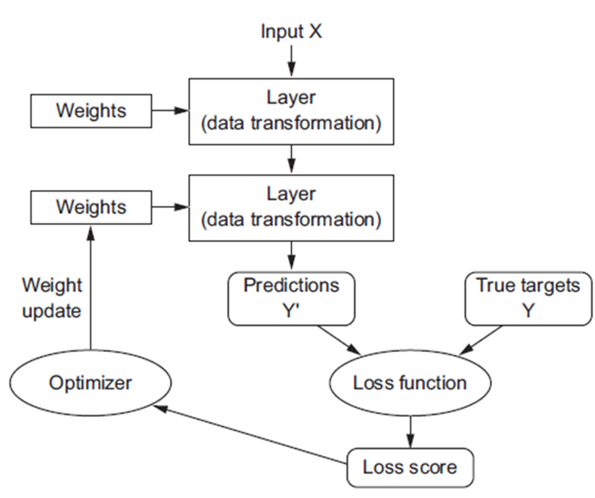
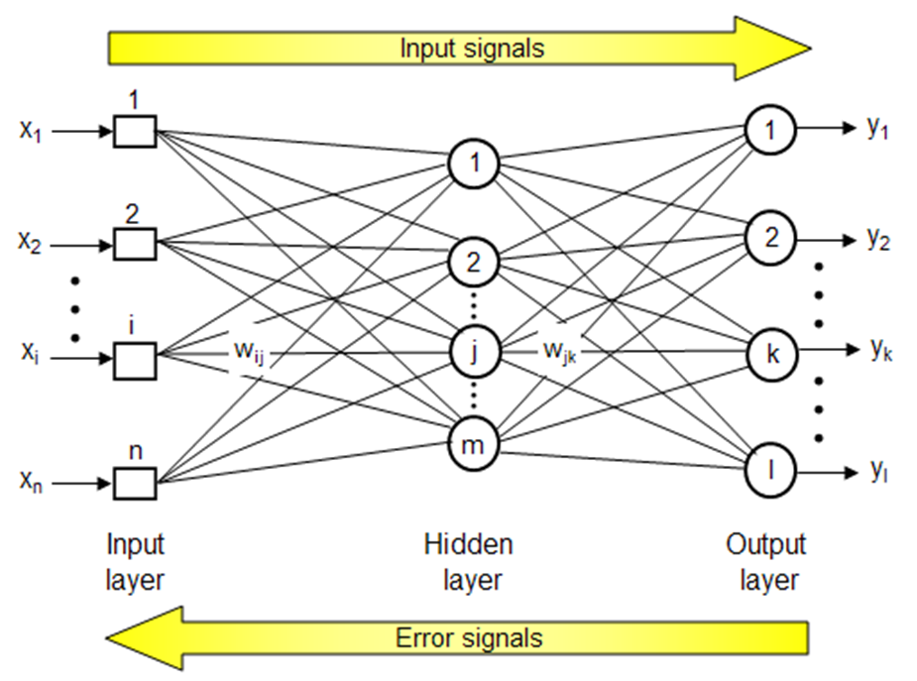
Conceptual overview of deep learning pipeline

Slide 21
Training loop
Repeat these steps in a loop, as long as necessary:
Draw a batch of training samples x and corresponding targets y.
Run the network on x (a step called the forward pass) to obtain predictions y_pred.
Compute the loss of the network on the batch, a measure of the mismatch between y_pred and y.
Update all weights of the network in a way that slightly reduces the loss on this batch.
You’ll eventually end up with a network that has a very low loss on its training data: a low mismatch between predictions y_pred and expected targets y.
The network has “learned” to map its inputs to correct targets.

Slide 22
Evaluating machine learning models
In machine learning, the goal is to achieve models that generalize (i.e. perform well on never-before-seen data)
Overfitting is the central obstacle to generalization
You can only control that which you can observe, so it’s crucial to be able to reliably measure the generalization power of your model.

Slide 23
Evaluating machine learning models
So far in this paper we have used a very simple technique for evaluating the performance of our model: train/test split
Developing a model always involves tuning its configuration: for example, choosing the number of layers or the size of the layers (called the hyperparameters of the model, to distinguish them from the parameters, which are the network’s weights).
You do this tuning by using as a feedback signal the performance of the model on the test data.
In essence, this tuning is a form of learning: a search for a good configuration in some parameter space.
As a result, tuning the configuration of the model hyper parameters based on its performance on the test set can quickly result in overfitting to the test set, even though your model is never directly trained on it.
Central to this phenomenon is the notion of information leaks. Every time you tune a hyperparameter of your model based on the model’s performance on the validation set, some information about the validation data leaks into the model
If you do this only once, for one parameter, then very few bits of information will leak, and your test set will remain reliable to evaluate the model. But if you repeat this many times—running one experiment, evaluating on the test set, and modifying your model as a result—then you’ll leak an increasingly significant amount of information about the test set into the model.
At the end of the day, you’ll end up with a model that performs artificially well on the test data, because that’s what you optimized it for
Training data
Test data

Slide 24
Training, validation, and test sets
State-of-the-art evaluation techniques of a model requires splitting the available data into three sets:
Training
Validation/development/dev
Test
You train on the training data and evaluate your model on the validation data.
Once your model is ready for prime time, you test it one final time on the test data.
In this way, no information leak from your hyper parameter optimization using the validation data leaks into the test data
one flaw: if little data is available, then your validation and test sets may contain too few samples to be statistically representative of the data at hand.
This is easy to recognize: if different random shuffling rounds of the data before splitting end up yielding very different measures of model performance, then you’re having this issue
K-fold validation is a way to address this
Training data
Validation data
Test data

Slide 25
K-FOLD CROSS VALIDATION
You split your data into K partitions of equal size
For each partition i, train a model on the remaining K – 1 partitions, and evaluate it on partition i
Your final score is then the averages of the K scores obtained
This method is helpful when the performance of your model shows significant variance based on your train/test split
Example of 3-fold cross validation:
Still need a test data set for a final evaluation of the performance or generalization capabilities of your model
Test data

Slide 26
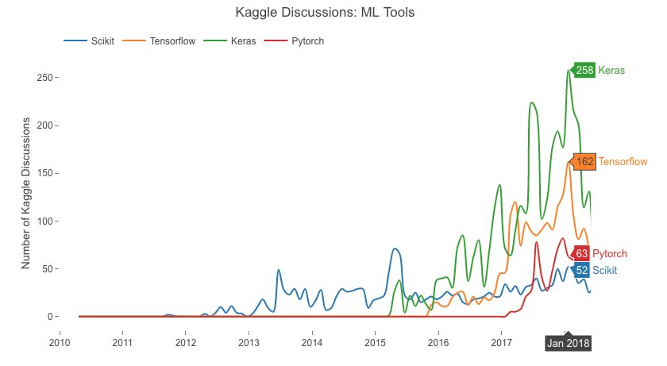

Keras is a deep-learning framework for Python that provides a convenient way to define and train almost any kind of deep-learning model
Keras was initially developed for researchers, with the aim of enabling fast experimentation
Keras has the following key features:
It allows the same code to run seamlessly on CPU or GPU
It has a user-friendly API that makes it easy to quickly prototype deep-learning models
It has built-in support for convolutional networks (for computer vision), recurrent networks (for sequence processing), and any combination of both
It supports arbitrary network architectures: multi-input or multi-output models, layer sharing, model sharing, and so on.
This means Keras is appropriate for building essentially any deep-learning model, from a generative adversarial network to a neural Turing machine.

Slide 27
Keras is a model-level library, providing high-level building blocks for developing deep-learning models.
It doesn’t handle low-level operations such as tensor manipulation and differentiation
Instead, it relies on a specialized, well-optimized tensor library to do so, serving as the backend engine of Keras
Rather than choosing a single tensor library and tying the implementation of Keras to that library, Keras handles the problem in a modular way
Thus several different backend engines can be plugged seamlessly into Keras. Currently, the three existing backend implementations are the TensorFlow backend, the Theano backend, and the Microsoft Cognitive Toolkit (CNTK) backend.
Keras adopted as tensorflow high-level API
Any piece of code that you write with Keras can be run with any of these backends without having to change anything in the code
Via TensorFlow (or Theano, or CNTK), Keras is able to run seamlessly on both CPUs and GPUs.
Notes:
TensorFlow, CNTK, and Theano are some of the primary platforms for deep learning
today. Theano (http://deeplearning.net/software/theano) is developed by the MILA
lab at Université de Montréal, TensorFlow (www.tensorflow.org) is developed by Google,
and CNTK (https://github.com/Microsoft/CNTK) is developed by Microsoft. Any
piece of code that you write with Keras can be run with any of these backends without
having to change anything in the code: you can seamlessly switch between the two
during development, which often proves useful—for instance, if one of these backends
proves to be faster for a specific task. We recommend using the TensorFlow backend as
the default for most of your deep-learning needs, because it’s the most widely adopted,
scalable, and production ready.

Slide 28
The typical Keras workflow looks like the following:
Define your training data: input tensors and target tensors.
Define a network of layers (or model ) that maps your inputs to your targets.
Configure the learning process by choosing a loss function, an optimizer, and some metrics to monitor
Iterate on your training data by calling the fit() method of your model.
from keras import models
from keras import layers
from keras import optimizers
model = models.Sequential()
model.add(layers.Dense(32, activation='relu', input_shape=(784,)))
model.add(layers.Dense(10, activation='softmax'))
model.compile(optimizer=optimizers.RMSprop(lr=0.001), loss='mse',metrics=['accuracy'])
model.fit(input_tensor, target_tensor, batch_size=128, epochs=10)
Notes:
TensorFlow, CNTK, and Theano are some of the primary platforms for deep learning
today. Theano (http://deeplearning.net/software/theano) is developed by the MILA
lab at Université de Montréal, TensorFlow (www.tensorflow.org) is developed by Google,
and CNTK (https://github.com/Microsoft/CNTK) is developed by Microsoft. Any
piece of code that you write with Keras can be run with any of these backends without
having to change anything in the code: you can seamlessly switch between the two
during development, which often proves useful—for instance, if one of these backends
proves to be faster for a specific task. We recommend using the TensorFlow backend as
the default for most of your deep-learning needs, because it’s the most widely adopted,
scalable, and production ready.

Slide 29
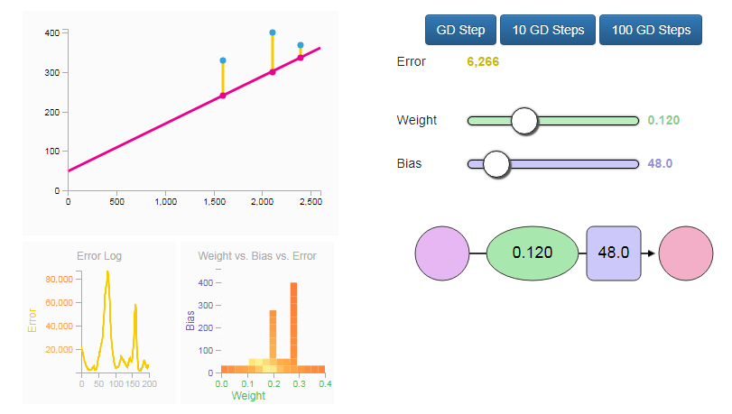
Recommended resources
A Visual and Interactive Guide to the Basics of Neural Networks: A Visual And Interactive Look at Basic Neural Network Math
A Visual And Interactive Look at Basic Neural Network Math

